Slide 1



SOCIAL BUZZ
CONTENT ANALYSIS
ALIYU KUBURAT
Notes:
This is Social buzz Analysis

Slide 2



Today's Agenda
Project Recap
Problem
The Analytics Team
Process
Insights
Summary
Notes:
And here is the agenda for the Analysis

Slide 3

Project Recap
Social Buzz: Navigating Explosive Growth
Social Buzz (500 million monthly users) seeks expert guidance to manage its rapid success.
Challenges:
Scaling infrastructure to handle a massive user base
Optimizing data management for effective analysis
Notes:
Social Buzz is experiencing significant growth, which has created challenges in managing its data infrastructure and optimizing user engagement. Accenture's engagement will provide a comprehensive approach, including improvements in data analysis, guidance for an IPO, and strategies for content optimization. By leveraging Accenture's expertise, Social Buzz can ensure continued success and a smooth transition to a public company.

Slide 4


Problem
Social Buzz: Unlocking the Power of User
Data Massive Data, Massive Opportunity
Social Buzz boasts over 500 million monthly active users generating a staggering:
100,000+ content pieces daily (text, image, video, GIF)
36.5 billion pieces of content annually
Notes:
The Social Buzz platform generates a large amount of user data, which presents a unique opportunity to gain valuable insights. Analyzing this data allows Social Buzz to:
- Understand user preferences and optimize content.
- Identify peak engagement periods to maximize impact.
- Refine content based on user reactions.
- Adapt the platform to user sentiment.
By harnessing these insights, Social Buzz can further engage its massive user base and solidify its position as a leading social media platform.

Slide 5




Andrew Fleming
(Chief Technical Architect)
The Analytics team
Marcus Rompton
(Senior Principle)
Aliyu Kuburat (Data Analyst)
Notes:
Here is the team that worked on the project.

Slide 6

The Define Objectives and Questions
Process
1
2
Gather the data needed for the analysis
Extract the relevant data needed to address the problem statement
3
Data Cleaning and Exploratory Analysis
4
Data Visualization and Recommendation
5
Notes:
"The process started with defining objectives and ended with the report"

Slide 7

Insights
1897
TOTAL REACTIONS
TO THE MOST
POPULAR
CATEGORY
6589
PHOTO IS THE HIGHEST SHARED CONTENT
MAY
MONTH WITH THE MOST POST
16
UNIQUE CATEGORIES
4
TYPE OF CONTENTS
Notes:
Here are insights from the data

Slide 8
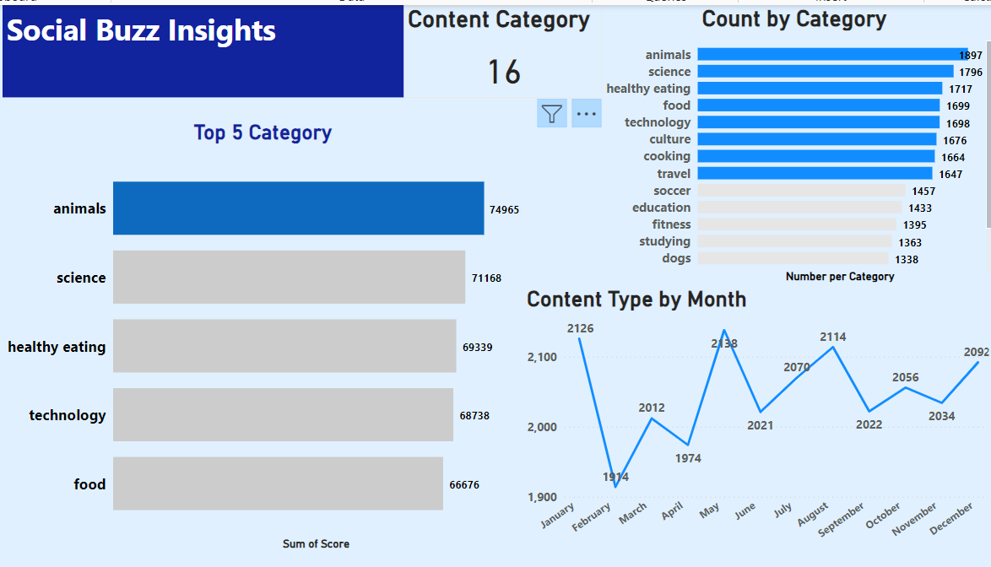


Slide 9
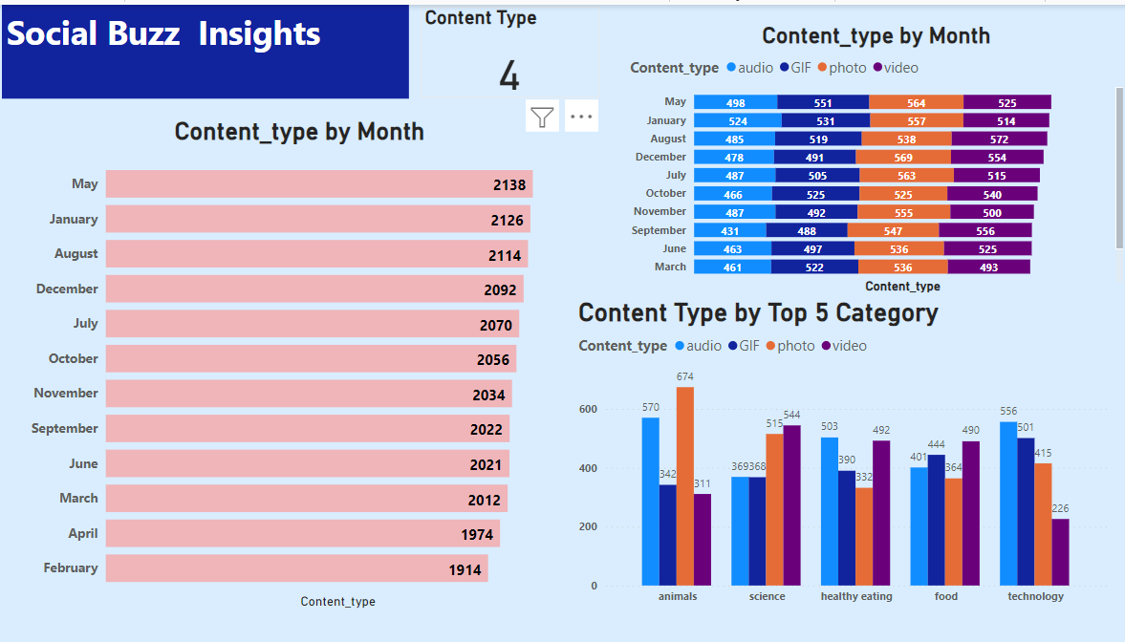
Notes:
13.12.2023
9

Slide 10
Decoding User Engagement
Top Content Categories & Engagement Trends
Social Buzz user data reveals fascinating insights into content preferences and user behaviour:
Animals Reign Supreme: Animal content takes the top spot with a 21.4% share (aggregate popularity score: 74,965).
Health & Food Focus: Food and Healthy Eating content rank highly, indicating user interest in wellness.
Diverse Interests: Science and Technology's presence showcases a broad user base with varied interests.
Engagement Patterns:
May is the Merrier Month: May boasts the highest engagement (2,138), while February sees the least (1,914).
Content Format Preference: Animal content thrives with photos, Science & Food with videos, Healthy Eating & Technology with audio, and GIFs see limited use (more prevalent in Technology).
Sentiment Analysis:
Science (Neutral Ground): Science content primarily evokes a neutral sentiment, suggesting informative appeal.
Notes:
The data from Social Buzz users provides valuable insights into their content preferences and engagement. Animal-related content is the most popular, followed by a strong interest in health and wellness, particularly in the Food and Healthy Eating categories. The presence of Science and Technology content indicates a diverse user base with varied interests. Platform activity is highest in May, while engagement is lower in February. Different content formats are preferred, with animal content performing well with photos, Science and Food with videos, Healthy Eating and Technology with audio, and limited use of GIFs, which are more prevalent in the Technology category. Science content tends to evoke a neutral sentiment, suggesting an informative appeal.

Slide 11
Based on the data analysis, here are some recommendations and next steps for Social Buzz:
Content Strategy:
Capitalize on Animal Popularity: While animal content is viral, investigate if the algorithm is over-favoring it. Ensure a healthy balance with other categories.
Cater to Health & Wellness: The high engagement for food and healthy eating content suggests a user interest in wellness. Develop more content in these areas, including recipes, fitness tips, and healthy lifestyle inspiration.
Diversify Content Formats: While preferences exist, encourage a wider variety of content formats. Explore promoting under-utilized formats like GIFs, especially for technology content.
Target Science Engagement: Analyze why science content receives mostly neutral reactions. Consider incorporating more engaging elements like interactive quizzes, experiments, or explainer videos.
Data-Driven Decisions:
A/B Testing: Conduct A/B testing to compare different content types, formats, and posting times to optimize for user engagement.
Sentiment Analysis Expansion: Expand sentiment analysis to other categories to gain a more comprehensive understanding of user reactions.
Notes:
Content Strategy Recommendations:
- Ensure balance across categories and investigate algorithm bias.
- Develop recipes, fitness tips, and healthy lifestyle inspiration.
- Encourage varied formats based on category preferences.
- Science Content Engagement: Include interactive elements to boost engagement.
Data-Driven Decisions:
- A/B Testing: Continuously test content types, formats, and posting times.
- Sentiment Analysis Expansion: Expand sentiment analysis to other categories.
Next Steps:
- Prioritize recommendations based on impact.
- Develop an action plan with specific tasks, timelines, and ownership.
- Continuously monitor user behaviour and adapt strategies based on new data and trends.

Slide 12


Social Buzz: A World of Opportunity
Social Buzz, a social media giant with over 500 million monthly users, is experiencing explosive growth. This translates to a vast amount of data generated daily, presenting both challenges and exciting opportunities.
Next Steps:
Prioritize recommendations based on potential impact.
Develop an action plan with tasks, timelines, and ownership.
Continuously monitor user behaviour and adapt strategies based on new data and trends.
By harnessing the power of user data and implementing these recommendations, Social Buzz can unlock its full potential, creating a more engaging and personalized user experience to solidify its position as a leader in the social media landscape.
Summary
Notes:
Social Buzz, a social media giant with over 500 million users, is challenged by managing a large amount of daily user data. This data offers an opportunity to enhance user experience and establish Social Buzz as an industry leader.
Next Steps:
1. Prioritize Recommendations:
2. Action Plan Development:
3. Continuous Monitoring:

Slide 13

Thank you!
ANY QUESTIONS?
Notes:
13.12.2023
11

